Slide 1
Stack Machine Simulator (Zero Address M/C)
Pankaj (UG201010025)
Sourabh(UG201010032)

Slide 2

Problem Statement
A stack machine (zero address machine) to simulate the interpretation of code written in assembly language having instructions: push, pop, add, sub, mult, div, disp. All binary arithmetic operators take operands from stack, while push pop are with reference to the accumulator, and disp shows the result. The objective is to interpret the code in step mode.

Slide 3
What Is a Stack Machine?
A Stack Machine is a real or emulated computer which uses pushdown stack to evaluate each sub-expression in the program.
A Stack Machine is programmed with a reverse Polish notation instruction set.

Slide 4
SP - Simulator
A Java program that simulates a user Assembly language program.
It reads program line by line and displays fetch and execution cycle.
Instruction set : push, pop, add, mul, sub, div, halt.

Slide 5
Algorithm
It works by maintaining a stack pointer.
For any binary operation the value must be greater than 1.It take two items from stack performs operation and put result back in stack.
For pop operation the value must be at least 1.It decreases stack pointer by one popping out value.
In push operation it pushes a value on top of stack thus increasing stack pointer by one.

Slide 6
Example
Instruction | Operation Performed | Values in Stack
Push A | Push the value stored in Accumulator in Stack | A
Push #5 | Fetch instruction and push value 5 in Stack | 5,A
Sub | Pop 5 and A and Push (A-5) in Stack | (A-5)
Pop A | Pop A from Stack | -
Halt | Stops the program | Stack is empty.

Slide 7
continue…
Stack after each step :
A
5
A
A-5

Slide 8
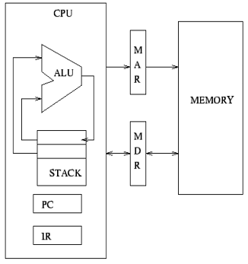
Stack Machine Architecture

Slide 9
Thank You

